Slide 1
Enhancing Network Efficiency : Integration of MAC protocol using dynamic bandwidth allocation AND Selective repeat with cumulative acknowledgement
Harry Pu
Samuel Ning

Slide 2

Motivation: MAC protocols integration
MAC protocols operates in DATA LINK layer.
Control how devices share the same medium.
Notes:
Now we will MAC protocols,, operate in the data link layer. Their primary purpose is to define how devices share the same medium effectively

Slide 3
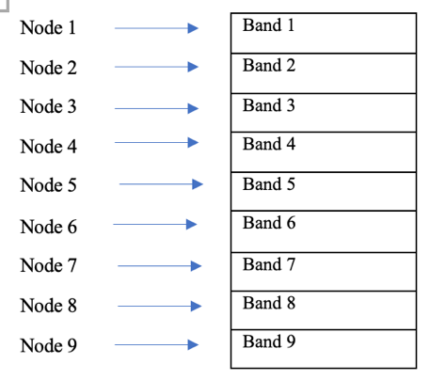
Motivation: MAC protocols integration
FDMA (Frequency Division Multiple Access)
Drawback: Unused Bandwidth
Notes:
FDMA is a type of MAC protocol that allows multiple devices to transmit at the same time by dividing the channel into different frequencies. However, there can in unused bandwidth and lead to lower efficiency.

Slide 4
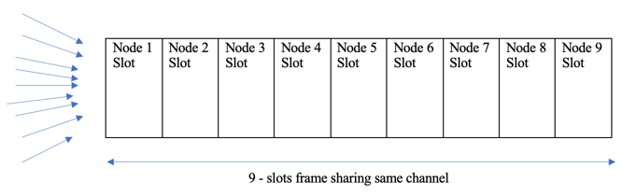
Motivation: MAC protocols integration
TDMA (Frequency Division Multiple Access)
Drawback: Inactive time slot.
Notes:
TDMA supports multiple accesss by allocating time slots to different devices in a cyclic manner. But TDMA also suffers from wasted resources due to inactive devices holding up the bandwidth during their time slot.

Slide 5
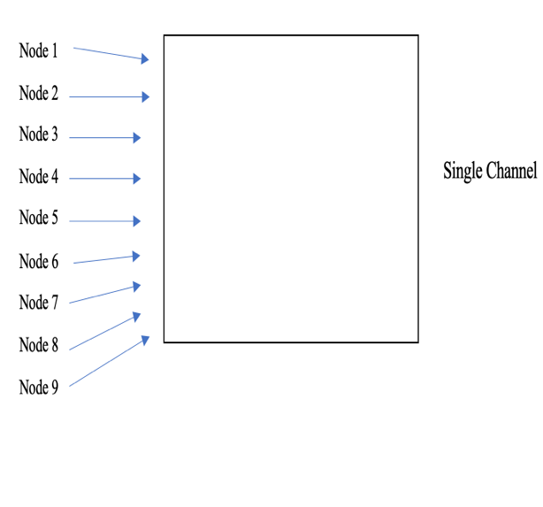
Motivation: MAC protocols integration
Random Access
Drawback: Higher collisions with large number of devices.
Notes:
Although the random access protocol does not waste any bandwidth, an increased number of devices can result in more collisions and lead to inefficiency

Slide 6
Motivation: MAC protocols integration
Attempt to improve transmission efficiency and throughput:
A mechanism that allocates bandwidth resource dynamically to different devices based on each device's bandwidth requirement.
Notes:
To effectively use the channel's bandwidth, and to improve the overall throughput, we need a mechanism that allocates bandwidth dynamically , based on device's bandwidth requirement

Slide 7
Motivation: MAC protocols integration
But how to know each devices bandwidth requirement?
Not a focus of this project. We assume it’s already known.
Possible solutions:
RNN machine learning, statistical model, AI…
Notes:
But how can we know each device's bandwisth requriement? We assume it is already known in this project.
We can use RNN machine learning to process device's short term traffic data, and make prediction of their bandwidth usage. In addition, we can also use AI or statictical model to make the prediction.

Slide 8
The simulation conditions:
Uses Python Simpy, a event driven simulation framework.
All simulation has 9 nodes with various data load for transmission, node 1 has the lowest data load and node 9 has the highest (know node’s bandwidth requirement).
Runs simulation for 1000 time units.
Full bandwidth for the channel is fixed.
Notes:
Here are some conditions of our simulation:
We ran all our MAC protocol simulations using the Python Sim pi framework. : All simulations has 9 nodes sending data with various loads from 1 to 9, where node 1 has the lowest data load, and node 9 has the highest data load. It is also assumed that our total bandwidth of the channel does not change. All simulations ran for 1000 time units.

Slide 9
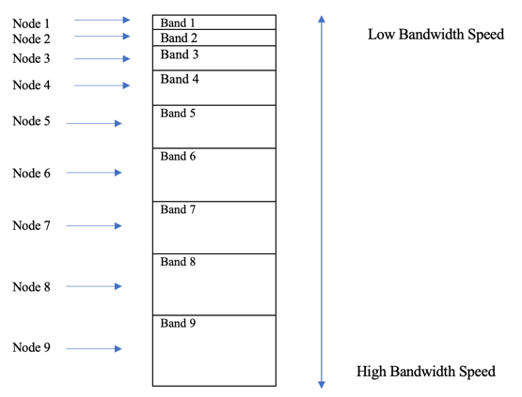
Uniform vs. Stratified Bandwidth allocation in FDMA
Uniform
Stratified
Notes:
The first improvement is to use stratified bandwidth allocation in FDMA. In the uniform allocation allprach, all nodes has the same bandwidth speed, regardless of their data load. In the stratified appraoch, the 9 nodes are assigned to a bandwidth speeds proportional to their data loads. That is, a node with a higher data load is assigned to a band with higher bandwidth, and vice versa.

Slide 10
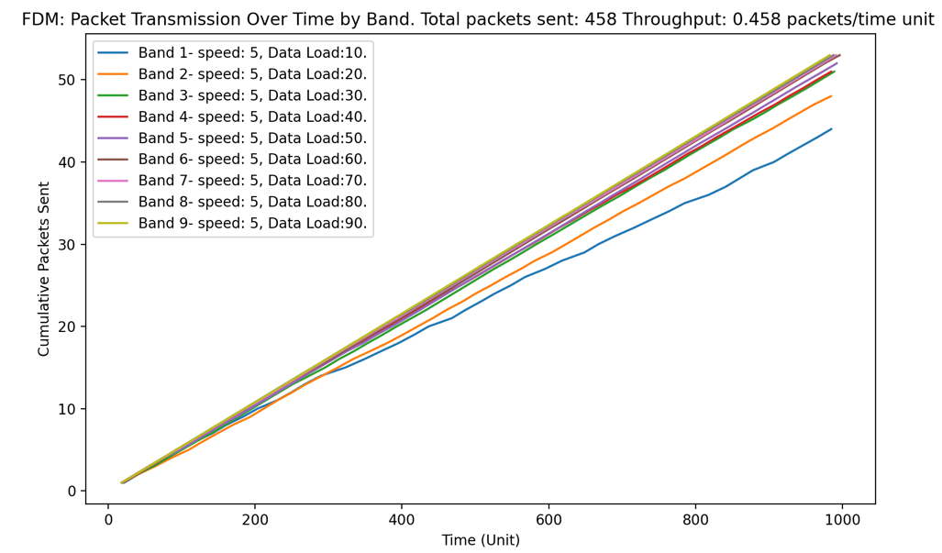
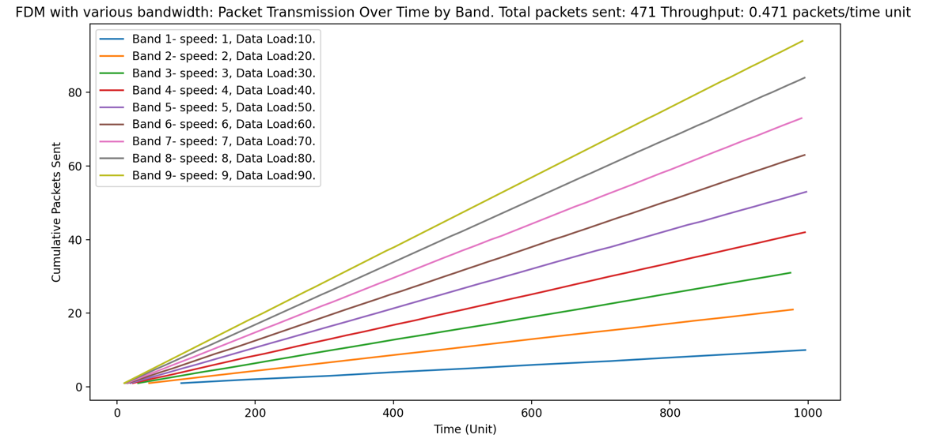
Simulation Results: Uniform vs. Stratified Bandwidth allocation in FDMA
Uniform
Stratified
Notes:
Our simulation results show the stratified bandwidth approach has a slightly higher overall throughput , which is 0.47 packets/time unit. On the left you can see all nodes have similar number of trnasmissions with unifrom bandwith. with stratified approach on the right, the busier nodes tranmit faster than the nodes with lower data load, whcih in turns increase the overall througput .

Slide 11
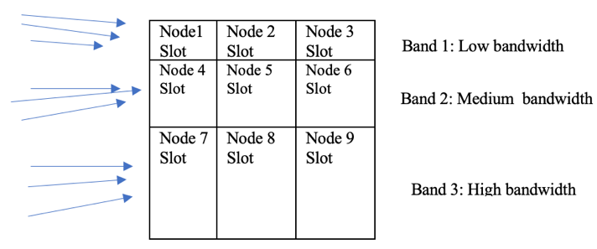
FDMA+ TDMA- Reduce idling time slot in TDMA
TDMA
FDMA + TDMA
Notes:
The second improvement we simulated is to intergrate FDMA with TDMA to reduce idling time slot in the original TDMA protocol. The 9 nodes are divided into 3 groups based on their data load: Node 1, 2, 3, are put in the first band, which has the lowest bandwidth. Node 7, 8, 9 are placed in the 3rd band , whcih has the highest bandwdith speed.

Slide 12
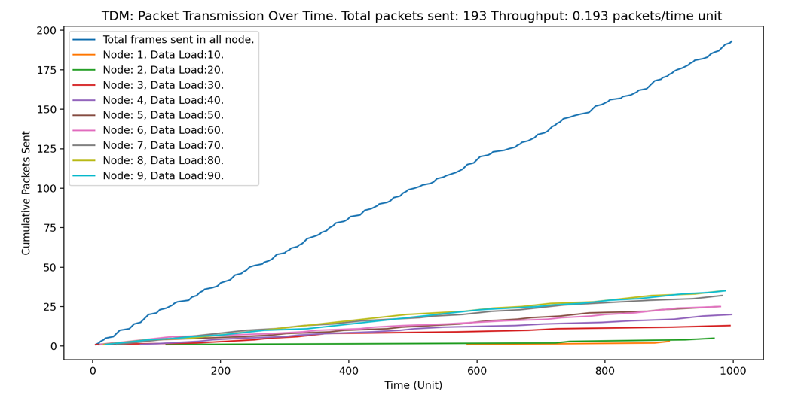
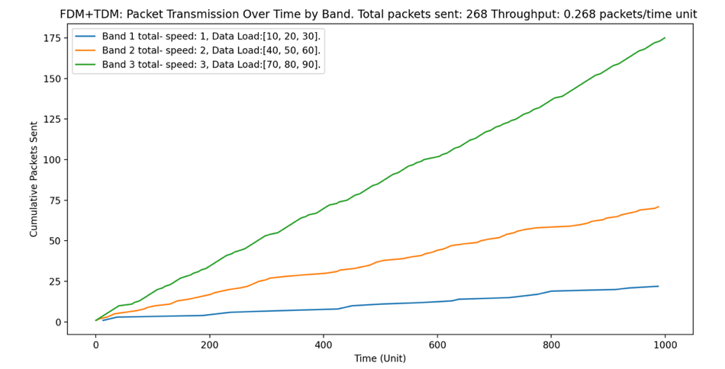
Simulation Results:FDMA+ TDMA
39% increase in throughput
TDMA
FDMA +TDMA
Notes:
The graph on the left shows the packets sent using TDMA. All 9 nodes share the same bandwidth in a single channel, resulting in an overall throughput of 0.19 packets/time unit and 193 total packets sent. The graph on the right shows the simulation results when combining FDMA with TDMA. this approach increases the throughput by around 39%, from 0.19 to 0.27 packets/time unit.

Slide 13
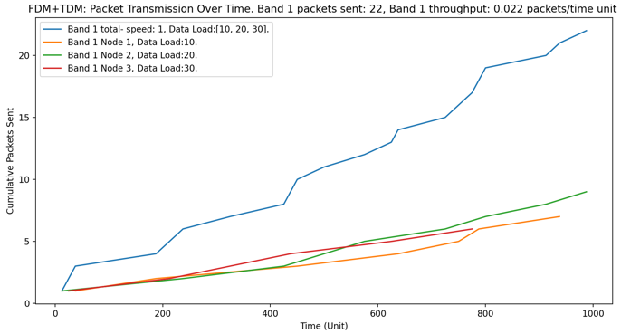
Simulation Results:FDMA+ TDMA.
Notes:
THis graph shows the first band's transmission in FDMA+ TDMA simulation. although the overall throughput improves after combining FDMA and TDMA, the nodes within each band still transmitt at similar rate, as the lines represending individual node in each bands, cluster together
After grouping nodes togheter and putting them in a band with matching bandwith based on the group's data load, furthur optimization within the band can be done.

Slide 14
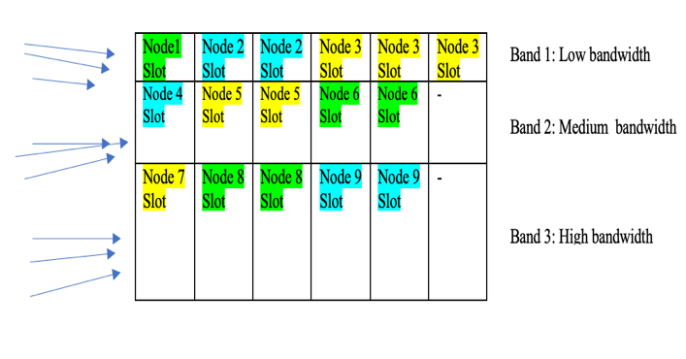
FDMA+ TDMA with Dynamic Slot Allocation
Regular FDMA +TDMA
With dynamic time slot allocation
Notes:
in this simulation we added dynamic slot allocation on top of FDMA + TDMA. each node is assigned with dynamic number of time slots. For instace, in band 1, node 1 gets 1 time slot to trasmitt, while node 2 and node 3 with higher data load get 2 and 3 time slots. In band 2, node 1 gets 1 time slot to transmit, while node 2 and node 3 get 2 time slots each. We hope this approach can help busier node to take more time slots, thus reudcing the idling slots.

Slide 15
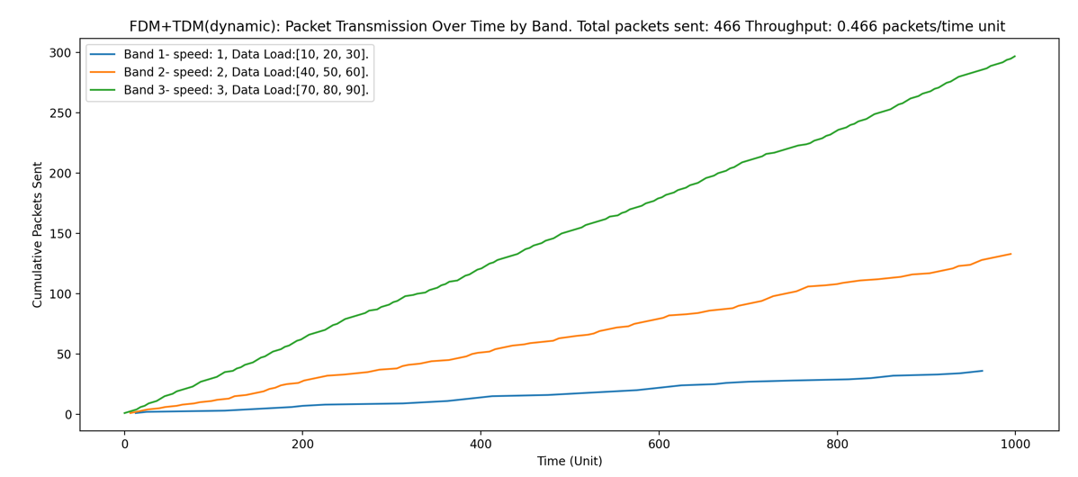
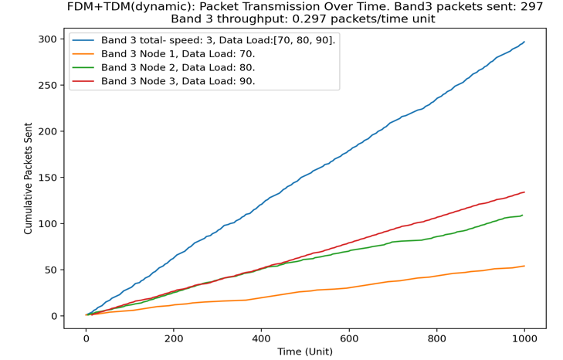
Simulation Results: FDMA+ TDMA with Dynamic Slot Allocation
268 frames -> 466 frames.
Throughput: 74% higher than without dynamic time slot
Allocation.
Node with higher data load strats to pick up speed.
Notes:
The results of this simulation is shown in the graph on the left. the overall transmitted packets is 466 and the throughput is 0.268 packets/time unit,This is 74% higher than the througput in the FDMA+TDMA simulation without dynamic slot allocation, and 140% higher throutput in the TDMA simulation. On the right is the graph shwing badn 3's tranmission in this dynamic approach. Comparing it with the FDMA + TDMA without the dynamic allocation, in the graph the nodes within a band start to differentiate in the number of packets transmitted. The nodes with lower data loads (such as node 1) do not lose too much throughput, while the nodes with higher data loads (such as nodes 2 and node 3 )start to pick up speed when utilizing dynamic time allocation.

Slide 16
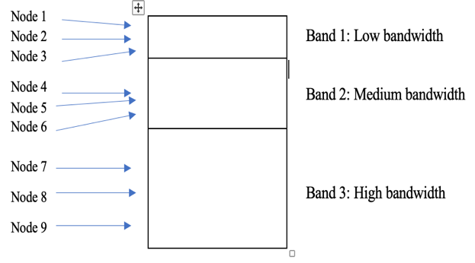
FDMA + Random Accesss
Random Access
FDMA + Random Access
Notes:
The last improvement in our simulation is to reduce the number of collisions in Random Access protocol by combining it with FDMA. Nodes are grouped together and assigned to a band based on their data load. Band 1 contains nodes with lower data loads and has the lowest bandwidth. Band 3 contains nodes with high data loads and has the highest bandwidth. Since there are less number of nodes sharing a band with this apporach, we expect the number of collitions to be reduced.

Slide 17
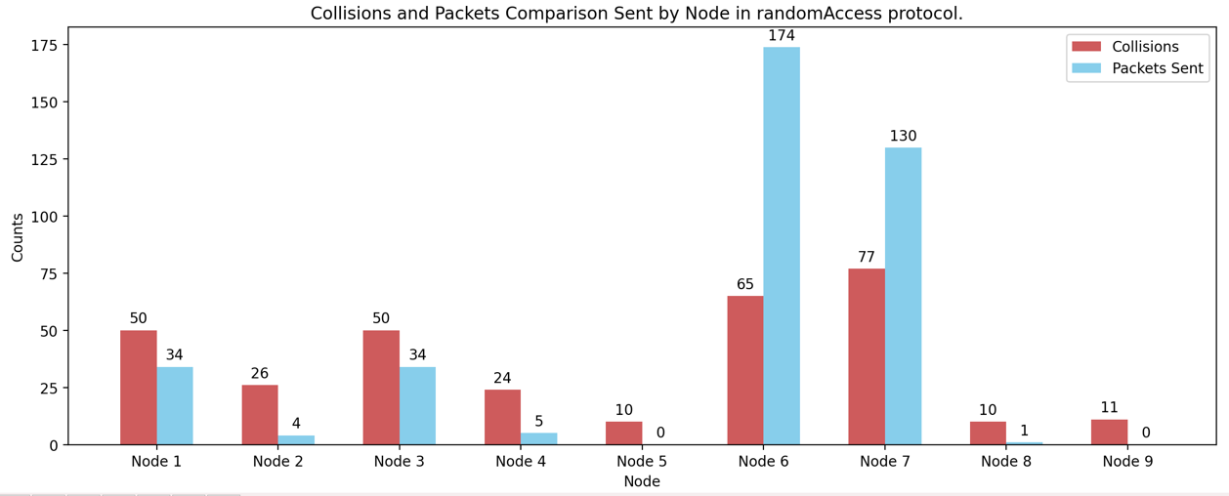
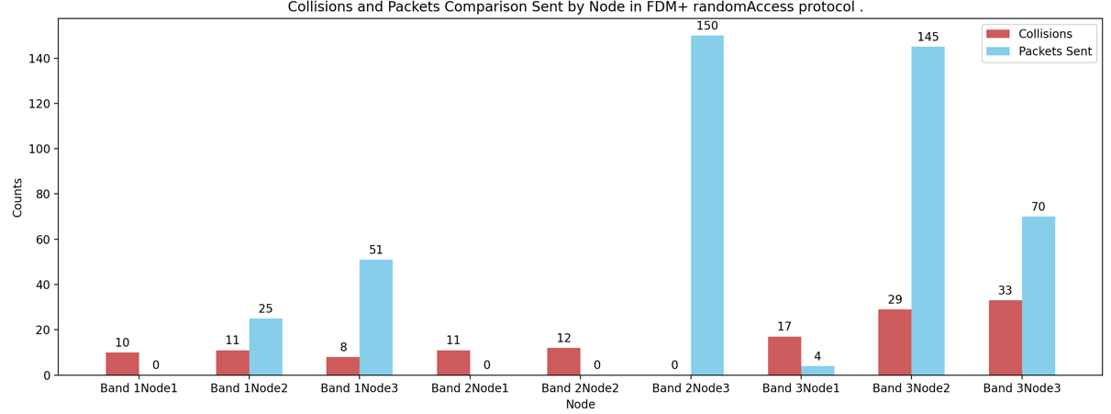
Simulation Result: FDMA + Random Access
Random Access: High collision rate: 45.8%
FDMA + Random Access: Lower Collision rate: 22.7%
Throughput improves by 16.5%, from 0.38 to 0.46 packets/time unit.
Notes:
Comparing this hybrid approach to the original random access protocol, the collision rate drops by almost half, from 45.82% to 22.74%. the hybrid approach effectively reduces collisions in all nodes.
Overall, combining FDMA with Random Access isolates the nodes in each band, effectively reducing the collisions and improving the overall throughput by about 16.5%, from 0.38 to 0.46 packets/time unit.

Slide 18
Selective Repeat Protocol
Sender and receiver both manage a window size.
Each frame has a sequence number to track order.
Sender sends frames within its window and times them.
If a frame times out (no acknowledgment), it's assumed lost and resent.
Out-of-order acknowledgment frames are buffered for sequential processing.
Receiver accepts and checks frames, reordering them correctly.
Out-of-order frames are stored until preceding frames arrive.

Slide 19
Selective Repeat with Cumulative Acknowledgment
Selective Repeat now includes Cumulative Acknowledgment feature.
Uses cumulative list instead of individual sequence numbers for acknowledgment.
List includes all sequence numbers of successfully received frames within receiver's window size.

Slide 20
Test Scenarios
Constant
Total frames to send (500)
Window size (5)
Timeout (1 second)
Network delays (minimum: 0.01 seconds, maximum: 0.05 seconds).
Different Frame loss rates:
High (30%)
Moderate (15%)
Low (5%).

Slide 21
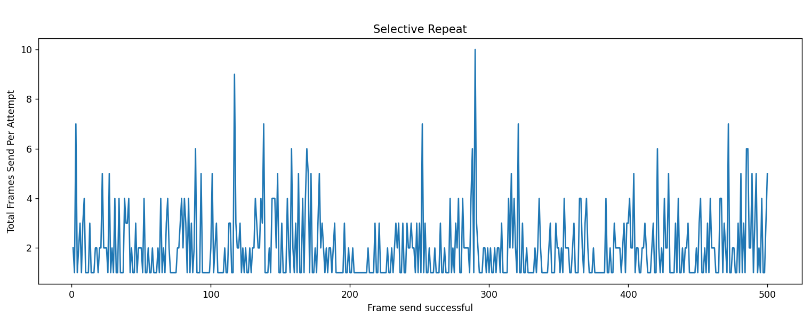
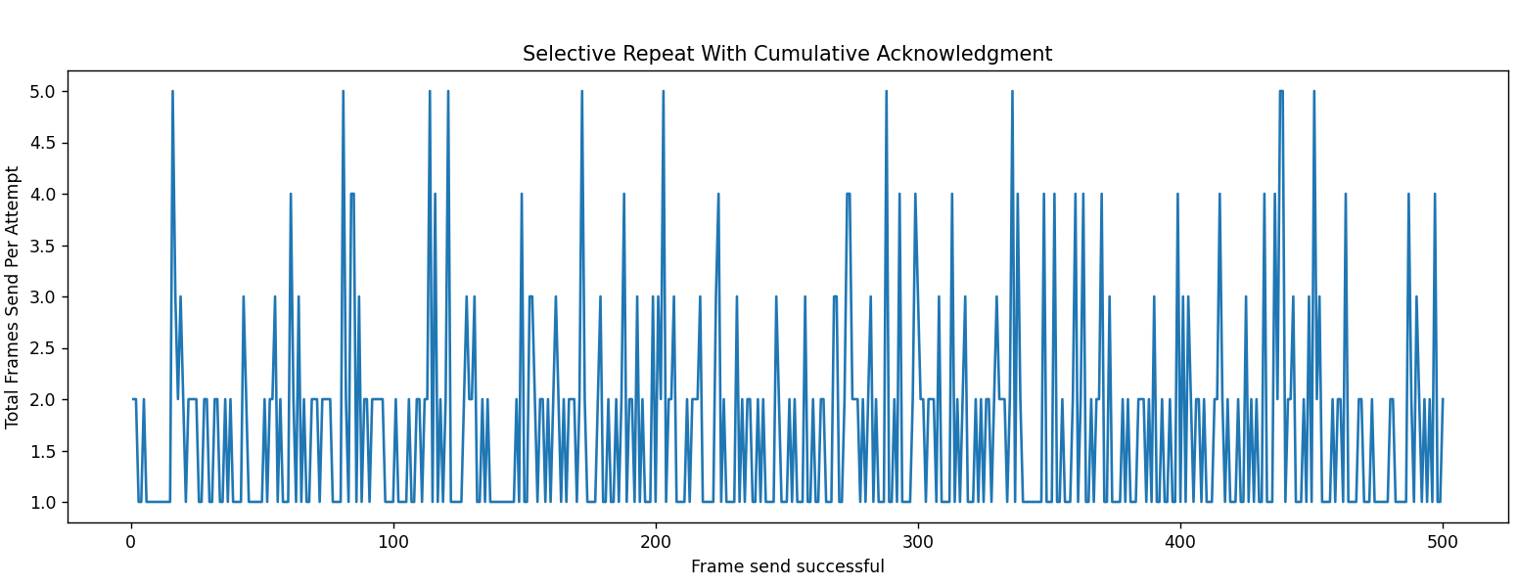
High Frame Loss Rate (30%)
Notes:
Our selevtive repeat with cummulative acknowlefgment out performs the regular selective repat the most when the loss rate is high. The graph on the left shows the total atemps per frames sent, it's effiecny is lower compared ot the grpah on the right with our modified aprpoach

